Slide 1

VISUALIZING EMPLOYEE ATTENDANCE TRENDS WITH EXCEL CHARTS
STUDENT NAME: ZAINAB FATHIMA M
REGISTER NO: 312217097 ( asunm1659312217097 )
DEPARTMENT: BCOM (GENERAL)
COLLEGE: SHRI KRISHNASWAMY COLLEGE FOR WOMEN
1
Notes:
1

Slide 2

PROJECT TITLE
VISUALIZING EMPLOYEE ATTENDANCE TRENDS WITH EXCEL CHARTS
2

Slide 3



AGENDA
Problem Statement
Project Overview
End Users
Our Solution and Proposition
Dataset Description
Modelling Approach
Results and Discussion
Conclusion
3/21/2024 Annual Review
3

Slide 4


PROBLEM STATEMENT
Data Overload: Difficulty managing large volumes of attendance data.
Lack of Clarity: Complex or unclear data presentation.
Inconsistent Reporting: Variability in data formats and reporting methods.
Real-Time Tracking: Challenges in updating attendance data in real time.
Absentee Trends: Difficulty identifying patterns and trends in absenteeism.
Integration Issues: Problems integrating attendance data with other HR systems.
Decision-Making: Inefficiencies in using attendance data for decision-making.
4

Slide 5

PROJECT OVERVIEW
Objective: Create clear, actionable visual representations of attendance data.
Data Sources: Integrate data from time clocks, HR systems, and manual logs.
Visualization Tools: Utilize dashboards, charts, and heat maps.
Real-Time Updates: Enable live data feeds and updates.
Trend Analysis: Identify patterns in attendance, including absenteeism and tardiness.
User Access: Provide access for HR, managers, and employees with role-based views.
Reporting: Generate regular and ad-hoc reports for insights and decision-making.
.
5

Slide 6

WHO ARE THE END USERS?
HR Teams: Manage attendance records and policies.
Managers: Track team attendance and address issues.
Employees: View their own attendance records and trends.
Executives: Monitor overall attendance patterns and make strategic decisions.
Payroll Teams: Verify attendance data for accurate payroll processing.
6

Slide 7
OUR SOLUTION AND ITS VALUE PROPOSITION
Intuitive Dashboards: Easy-to-understand visual summaries of attendance data.
Real-Time Updates: Instant access to current attendance information.
Trend Analysis: Identifies patterns and trends for proactive management.
Customizable Views: Tailored visualizations for different user roles.
Integration: Seamless connection with HR and payroll systems.
Alerts and Notifications: Automated notifications for attendance anomalies.
7

Slide 8
Dataset Description
Employee ID: Unique identifier for each employee.
Dates: Attendance records for specific dates.
Clock-In/Clock-Out Times**: Time stamps for work hours.
Absenteeism Records: Details of absences, including reasons.
Late Entries: Instances of tardiness.
Leave Types: Vacation, sick leave, and other leave categories.
Shift Information: Details on shift timings and schedules.
Department: Employee's department or team.
Attendance Status: Present, absent, on leave, etc.

Slide 9
THE "WOW" IN OUR SOLUTION
Dynamic Dashboards: Interactive, customizable visual displays.
Real-Time Data: Live updates on attendance records.
Advanced Analytics: In-depth trend analysis and pattern recognition.
Automated Alerts: Instant notifications for attendance issues.
Seamless Integration: Smooth data sync with HR and payroll systems.
User-Centric Design: Tailored views for different user roles.
Historical Data Access: Comprehensive access to past attendance data.
-Mobile Compatibility: Access from any device for flexibility.
3/21/2024 Annual Review
9

Slide 10
MODELLING
Attendance Patterns: Analyzing trends and recurring attendance issues.
Shift Coverage: Assessing adequacy of staffing and shift allocations.
Absenteeism Trends: Identifying patterns in absences and lateness.
Real-Time Monitoring: Tracking current attendance data and anomalies.
Historical Comparisons: Comparing current data with past attendance records.
Predictive Analytics: Forecasting future attendance patterns and needs.
Departmental Analysis: Evaluating attendance by department or team.
Integration with Payroll: Aligning attendance data with payroll processing.
10

Slide 11
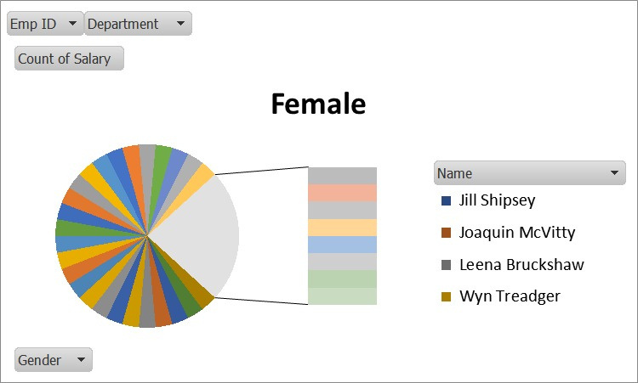
RESULTS
11

Slide 12
conclusion
"Data visualization reveals key attendance insights, including peak absence times and departmental trends. These findings will inform targeted interventions, scheduling decisions, and strategies to boost attendance and engagement, driving business outcomes and improving employee management."

